Slide 1






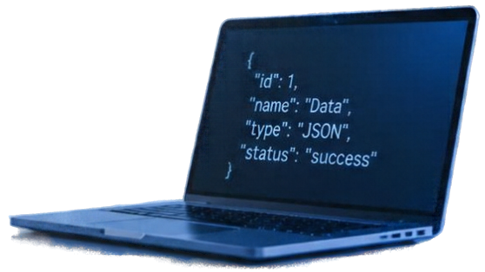
JSON-Based RESTful Services
Concepts, Working, HTTP Methods, and Applications
REST
JSON
HTTP

Slide 2







Introduction to JSON and REST
JSON is JavaScript Object Notation,
a lightweight format to exchange data.
JSON
REST
REST is Representational State Transfer, a way to design web services using HTTP.
Lightweight
Data
Format
Fast and
Easy
Communication
Web Services
Using
HTTP
JSON is easy to read and widely supported.
REST defines how web services work.
Together, JSON and REST enable
fast and simple communication.

Slide 3










Client-Server Architecture
Client
REST API
Server
Data Storage
A client sends requests, the REST API forwards them to the server, and data is stored and retrieved securely.
User or application requesting data
Interface handling HTTP
requests
Processes requests and manages
data
Database or storage system
HTTP Request
HTTP Response

Slide 4
















Working of JSON-Based RESTful Services
1
2
3
4
CLIENT
Client sends HTTP request (GET, POST,
etc.)
Server receives and processes the request
Server retrieves or updates data accordingly
Server returns HTTP status code and
JSON response
SERVER
JSON RESPONSE

Slide 5




HTTP Methods
GET
Retrieve data from the server
Example:
Get a list of users
POST
Create a new resource
Example:
Add a new user
PUT
Replace or update a resource fully
Example:
Update user details completely
PATCH
Partially update a resource
Example:
Update a user’s email only
DELETE
Remove a resource
Example:
Delete a user account

Slide 6


JSON Data Format
Example JSON
JSON stores data as key-value pairs inside braces {}.
{
"id": 101,
Keys like "id" and values like 101
make up the data.
"name": "Laptop",
Strings like "Laptop" are text;
numbers like 25 and 50000 are numeric.
"quantity": 25,
"price": 50000
Multiple objects can be stored in arrays (list of objects).
}
JSON is used in both request
and response bodies.

Slide 7













Practical REST API Example
Sample: Get Product with ID 101
Example endpoints for an inventory management system.
Request
GET
/api/products
get all products
GET /api/products/101 HTTP/1.1
Host: api.example.com
GET
/api/products/101
get product with id 101
Response (200 OK)
POST
/api/products
add a new product
{
"id": 101,
"name": "Wireless Mouse",
"category": "Electronics",
"price": 25.99,
"stock": 150
}
PUT
/api/products/101
update product 101 fully
DELETE
/api/products/101
delete product 101

Slide 8


















Real-World Applications
JSON-based RESTful services power many everyday digital experiences.
E-commerce apps: product listings, orders
Banking: account info, transactions
Weather apps: forecasts and alerts
Mobile apps: syncing data and updates
Cloud services and inventory management

Slide 9




Advantages and Limitations
ADVANTAGES
LIMITATIONS
Lightweight and easy to read
Needs security (authentication, encryption)
Works with many programming languages
Depends on network connection for remote calls
Easy to integrate with
apps and websites
JSON size can be bigger
than some binary formats
Good for web and
mobile applications

Slide 10


Conclusion
Thank You
JSON and REST work together using HTTP to enable APIs
They allow different apps to
communicate easily
JSON-based RESTful services
power many modern applications

